Slide 1

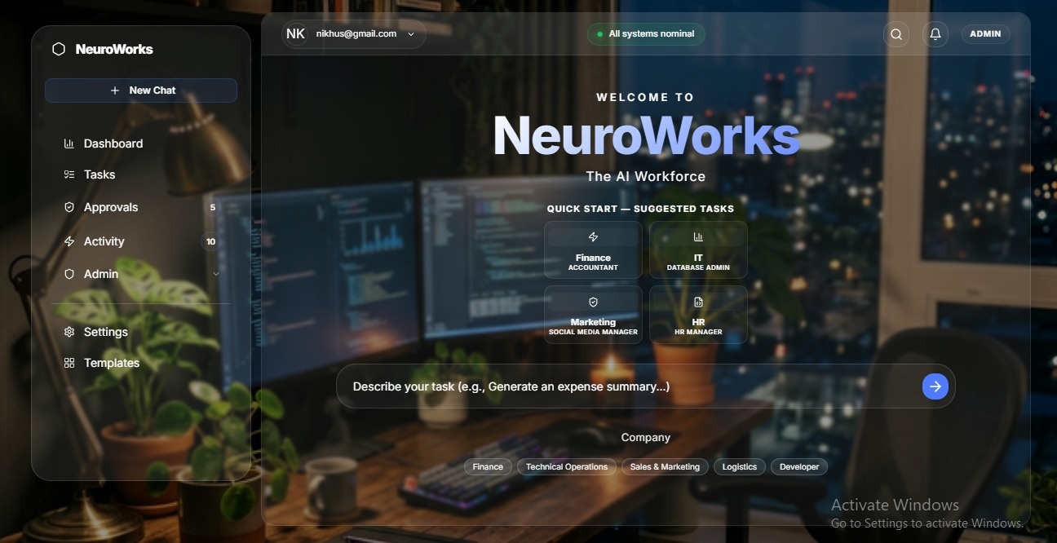
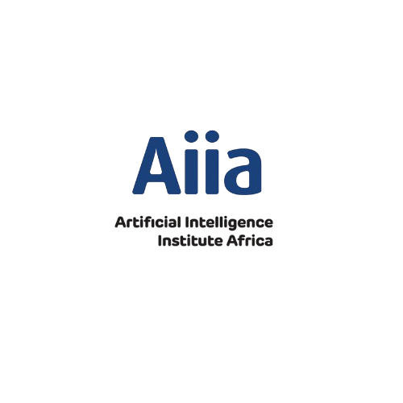
NeuroWorks
AI workforce
01
Natural Language Input or Job Description
Employees can describe tasks using natural language, making interaction simple and intuitive for everyone involved. Or upload a job description that will frame the AI’s tasks
02
Process Automation
The system efficiently translates requests into structured workflows, automating tasks across multiple systems to enhance productivity. The system converts business processes into AI workflows.
03
Comprehensive Governance
Built-in governance features ensure security and compliance, with approvals and audit trails maintaining organizational integrity throughout processes.

